Slide 1
Analytics and Data Exploration
Introduction to Analyzing Data for Business Goals

Slide 2
Learning Goals
Explore and evaluate data analytics tools
Choose the analysis strategy and the techniques to explore the collected data for your project
Categorize a dataset and explain what the data means
Differentiate statistical analysis and exploratory data analysis
Define methods of collecting and interpreting data

Slide 3
Organizing and Analyzing Data
Use data to improve your business
Make data-driven, evidence-based business decisions
Understand what your customers think and how they feel
Identify the latest trends applicable to your business
Improve internal operations and processes
Stay compliant with data protection regulations

Slide 4
Considerations when Analyzing Data
Define your questions.
Set clear measurement priorities.
Decide what to measure.
Collect the data.
Analyze the data.
Notes:
Your first challenge is identifying or defining the specific data that can help answer your questions, draw accurate conclusions, and enhance your decision-making process. Here are five steps in the data analysis process to consider.

Slide 5
Interpretation and Subjectivity
Qualitative vs Quantitative
Qualitative
Observations
Documents
Interviews
Quantitative
aka “numberical”
most common statistical terms used in Qualitative Data interpretation: mean, standard deviation, frequency distribution, regression analysis

Slide 6
Interpretation and Subjectivity
Why is interpretation important?
Useful and usable information
Informed decision-making
Needs anticipation
Trend analysis
Cost efficiency
Performance understanding
Notes:
The goal of collection and interpretation is to gain useful information that can be used

Slide 7
Common Problems in Data Interpretation
Correlation and causation
Confirmation bias
Irrelevant data
Notes:
The goal of collection and interpretation is to gain useful information that can be used

Slide 8
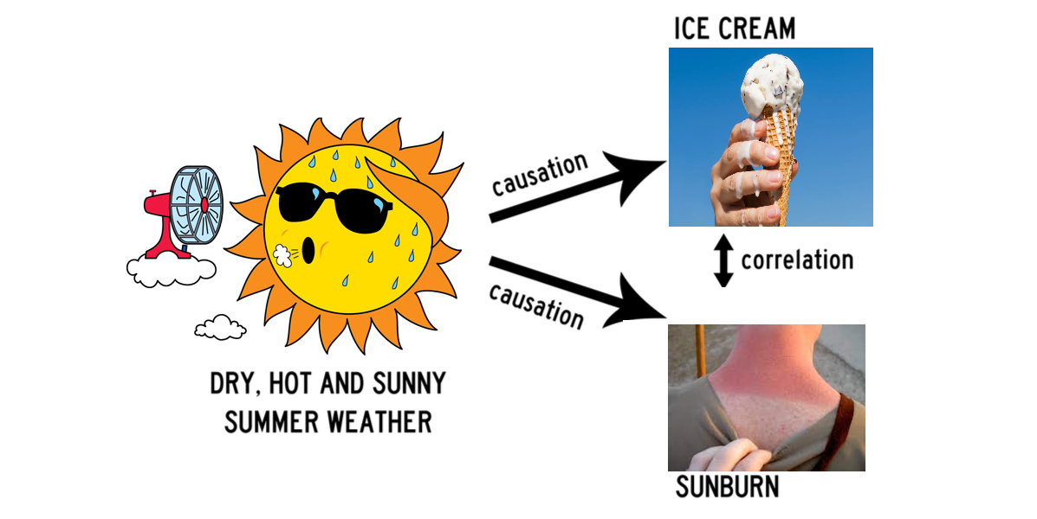
Causation VS Correlation

Slide 9
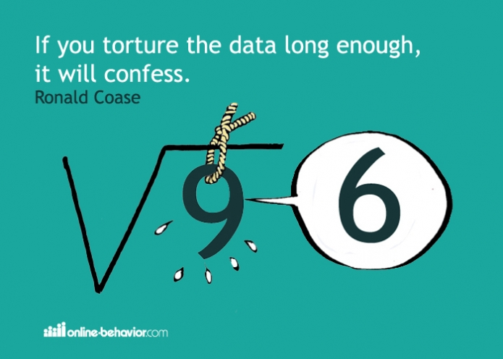
Be Careful

Slide 10
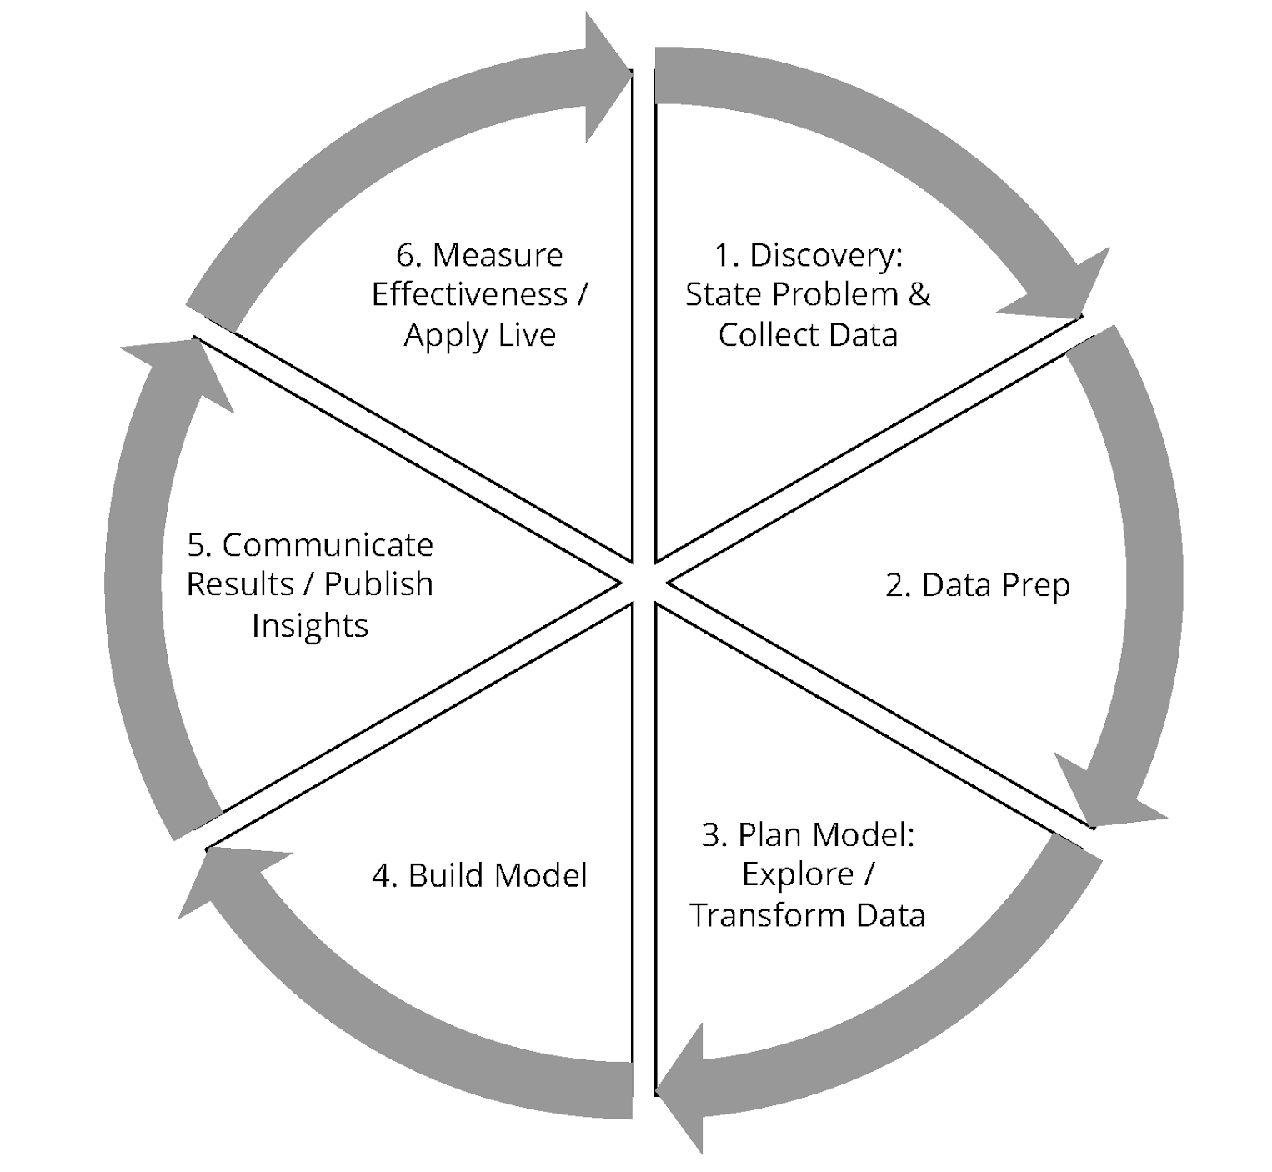
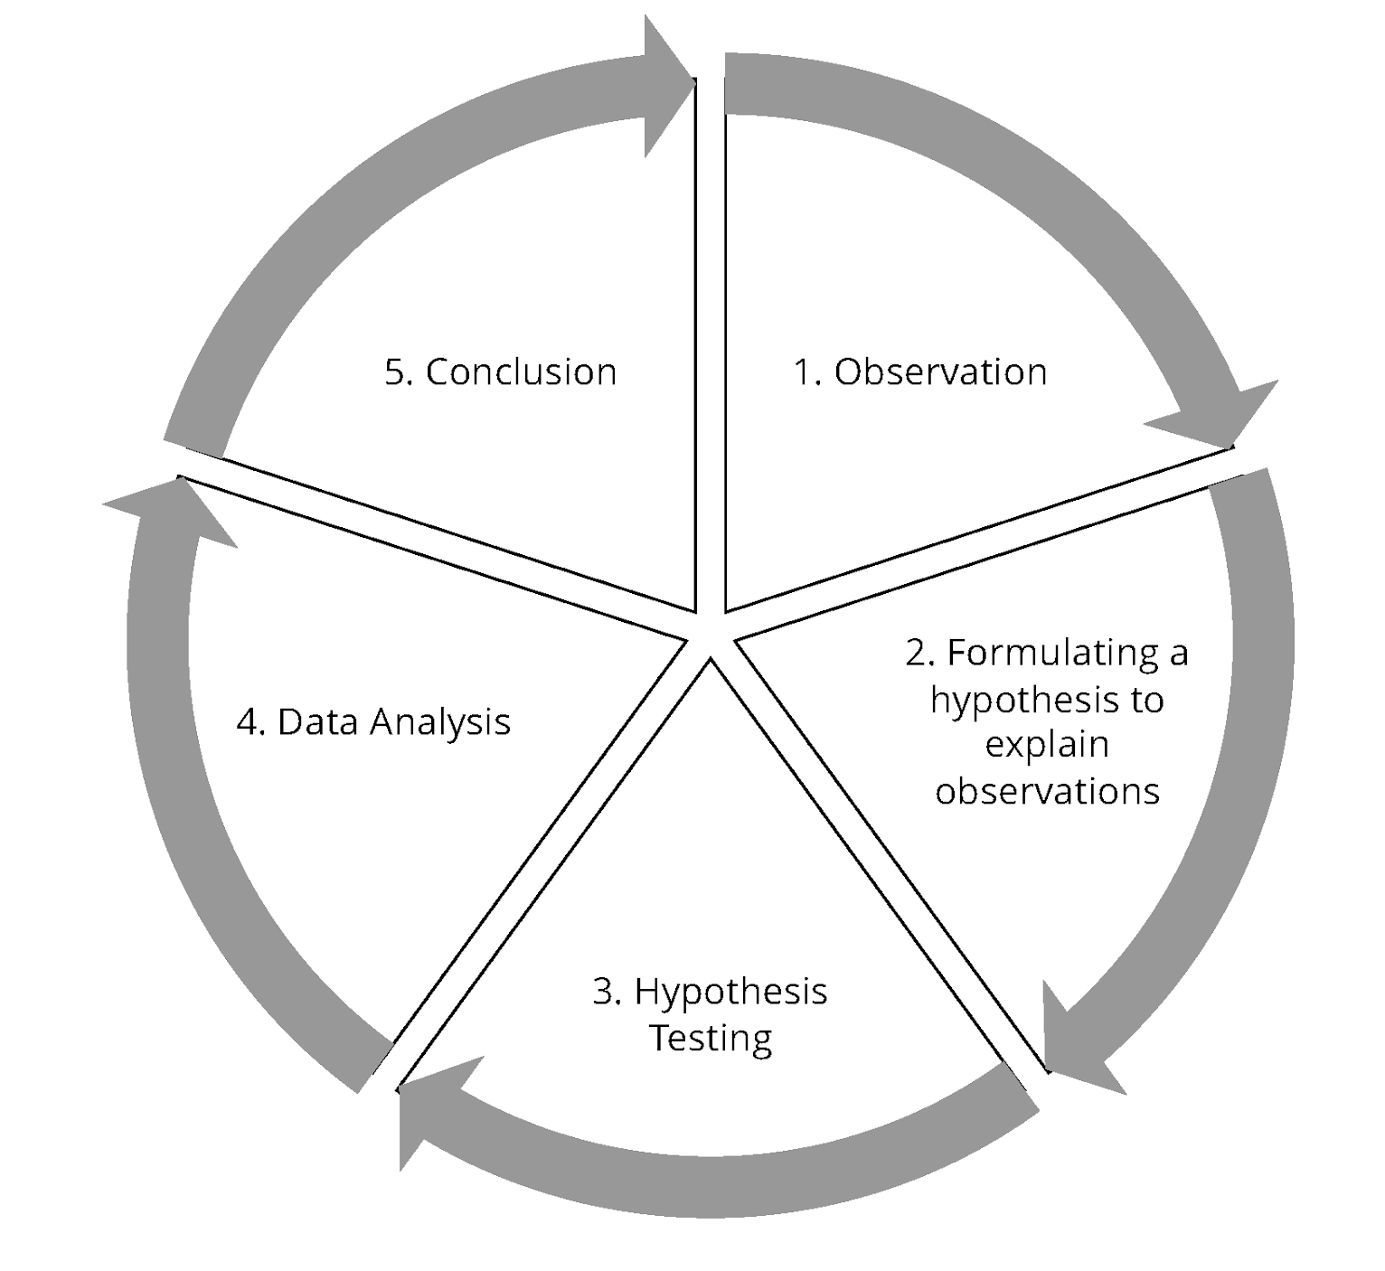
Statistical Analysis vs Data Analysis
Statistical Analysis | Data Analysis

Slide 11
Statistical Analysis vs Data Analysis
Statistical analysis allows you to gain an understanding of a population from an analysis of a small but representative subset (a sample) of that population.

Slide 12
Statistical Analysis vs Data Analysis
In turn, data analysis is a procedure for investigating, cleaning, transforming, and training the data with the aim of finding useful information, drawing conclusions, and helping with decision-making

Slide 13
Exploratory Data Analysis (EDA)
Exploratory data analysis (EDA) employs a variety of techniques (mostly graphical) to:
Maximize insight into a data set
Uncover underlying structure
Extract important variables
Detect outliers and anomalies
Test underlying assumptions
Develop models
Determine optimal factor values

Slide 14
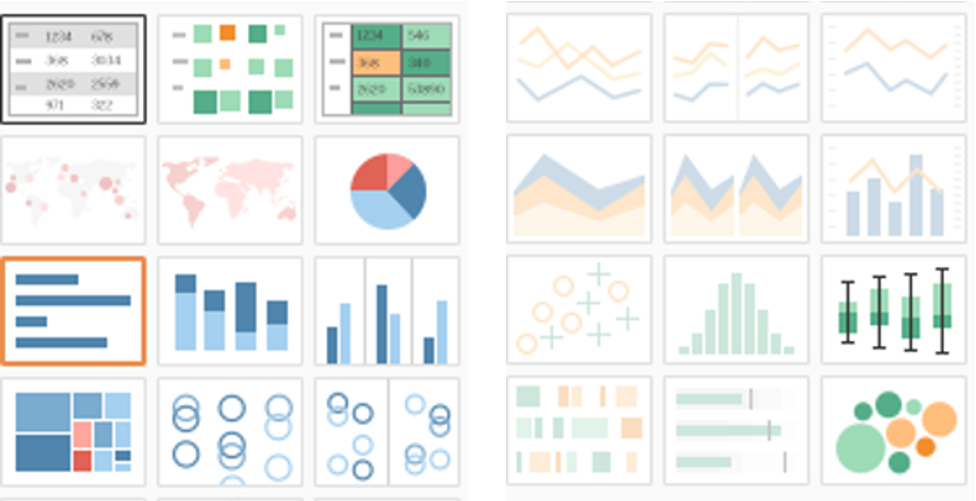
EDA
The above templates from Tableau illustrate the different plots used in EDA

Slide 15
EDA
Characterizing the Data
Understanding the Data
Variables
- Quantitative and Qualitative (Categorical)
- Discrete and Continuous
Data Types and Plotting
Data Cleaning and Maintenance

Slide 16
Variables
Variable
Qualitative
(Non-numerically)
Quantitative
(Numerically)
Discrete
Continuous

Slide 17
Discrete and Continuous
Discrete Variables | Continuous Variables
Have only a finite or countably infinite set of values Include zip codes, counts, or the number of words in a collection of documents Are often represented as integers | Have real number values Include such quantities as temperature, height, or weight Can only be measured and represented using a finite number of digits Are typically represented as floating-point variables

Slide 18
Final Project Check in

Slide 19
Data 2 Exercise:
Breakout rooms with small groups
We will have a more concrete example than the general exercise in Canvas
Be prepared to share your summary with the class in about 30 minutes

Slide 20
Data 2 Exercise: Instructions
Work with your breakout group to discuss the following: Imagine you have been working for a consultancy company for several years and have some analytics experience under your belt.
A data science project has just been assigned to you by your boss. Using the CRISP-DM process as a guide, what would be your course of action from start to finish?
Write your course of action in a short summary to share with the class. Use CRISP-DM as guidance for the step-by-step process but also feel free to add your own flair to it.
Provide as many details as you can for each step of the CRISP-DM process.
Make sure to identify the risks involved in each step.

Slide 21

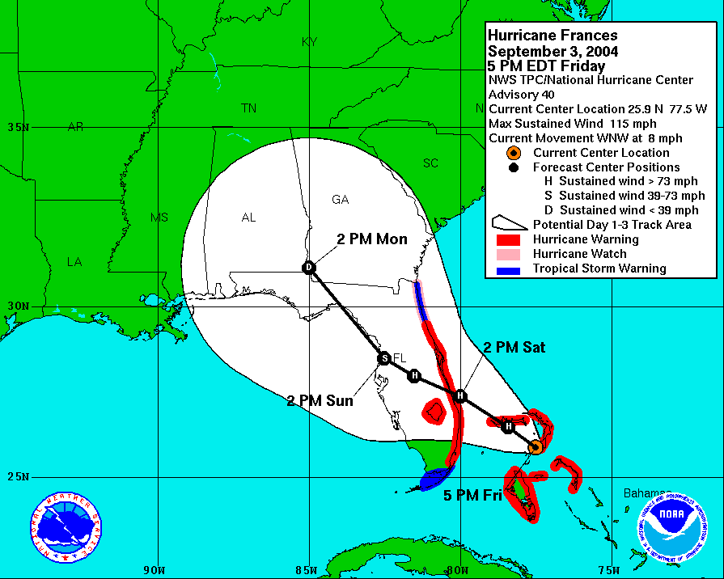
Group Discussion: Hurricane Frances
What will people buy from Walmart stores in the path of a hurricane?
The obvious items:
Flash lights, bottled water canned food, batteries, etc.
The not so obvious: Can DS help find these? How?
What will it mean to the business to have this knowledge?

Slide 22

Group Discussion: Hurricane Frances
Strawberry PopTarts increase in sales, as much as seven times their normal sales rate, ahead of a hurricane.”

Slide 23

Group Discussion: Hurricane Frances
Top pre-hurricane selling item: BEER

Slide 24

Q&A
What questions and comments do you have?

